Slide 1

Feeding the Machine Analysis of Semantic Alerts from Security Tools
Alexander Keddy
MCSc
GoSecure Atl.
http://wallpapercave.com/wp/kDjTosf.png

Slide 2
About Me

Slide 3
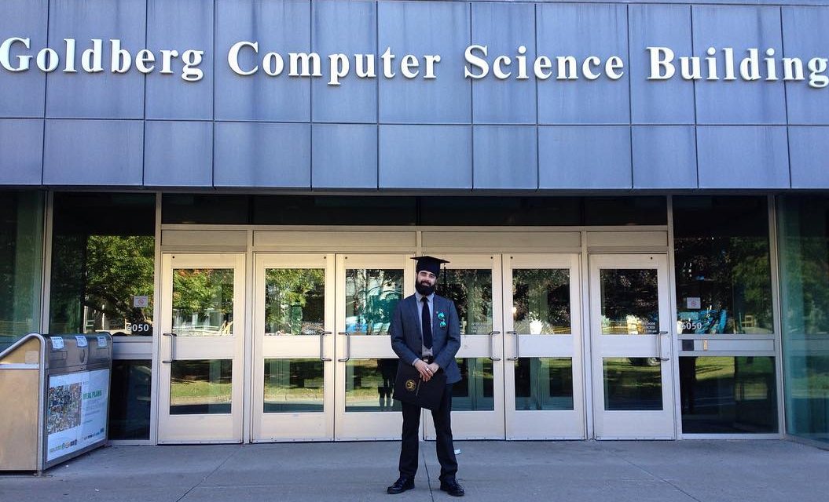
About Me: School
Notes:
Graduated from Masters of Computer Science in 2016
Worked on projects ranging from display GIS data for the next generation sequencing of pathogens to predicting fertility markers in cattle using machine learning

Slide 4
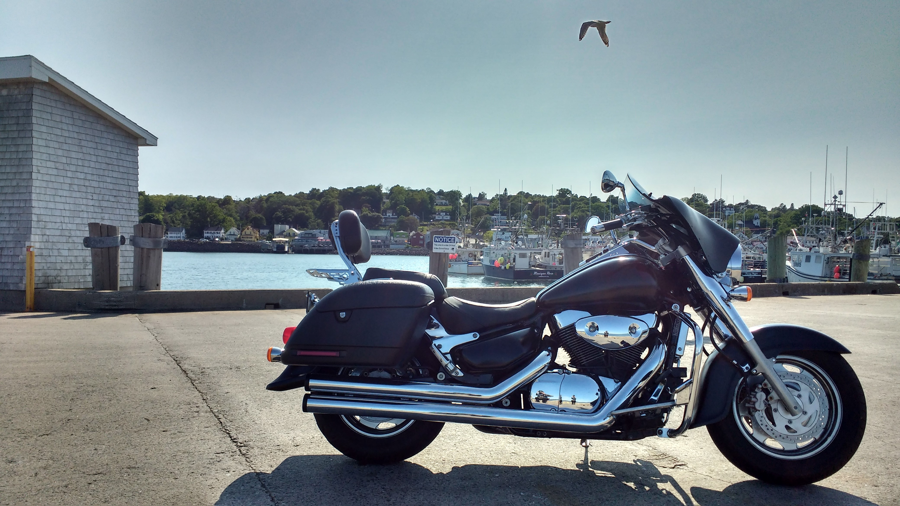
About Me: Life
Notes:
I spend a lot of my free time riding motorcycles

Slide 5


About Me: The Man, The Myth, The Nerd
https://pbs.twimg.com/media/C9nxVrmXYAAQM2-.jpg
Notes:
My favorite super hero is Batman, and I will gladly debate you on any of the finer points

Slide 6
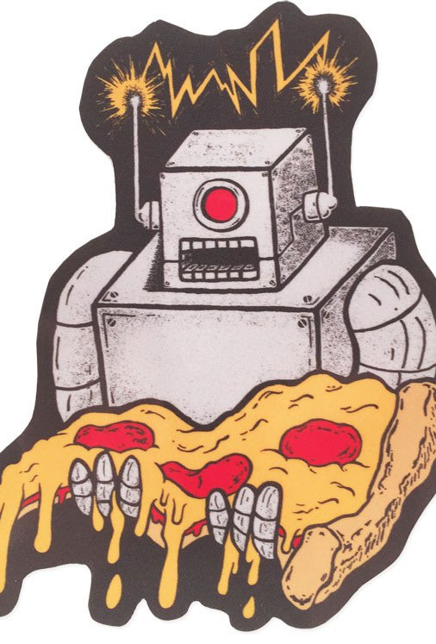
Requirements
Python
Alert Syntax Familiarity
Coffee
Available At:
github.com/akeddy/AtlSecCon2017
https://cdn.shopify.com/s/files/1/0651/7205/products/hungryrobotsticker2_1024x1024.jpg?v=1478526313
Notes:
But having any problem in mind is fine
Don’t worry, no math!

Slide 7

The New Frontier
Machine Learning is:
Accessible
Cheap (free!)
Ubiquitous
https://www.sciencefriday.com/wp-content/uploads/2015/04/shutterstock_181640888.jpg
Notes:
We’ve reached a new frontier in understanding where machine learning for the first time is not only everywhere, it is accessible. You no longer need to scour through Phd thesis to find algorithms and then implement them yourself. Vast libraries exist to bring every possible facet to you, and largely for free. Not only are these frameworks free to use, they are supported by some of the biggest names in the tech business!

Slide 8




The New Frontier
It’s even making suggestions for this Power Point presentation!
Notes:
Social Media
Online Shopping
Smart phone profiles
Keyboard Predictions
It’s even making suggestions for this Power Point presentation!

Slide 9
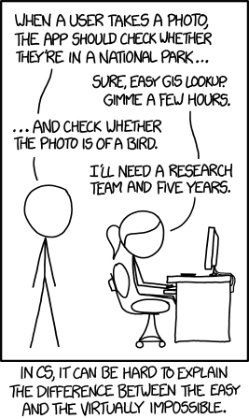
The New Frontier: It’s a bird, it’s a … Park?
Notes:
In CS it can often be very difficult to determine or explain what is a difficult problem vs an easy one
What we do know is that for a lot of problems machine learning seems to become a better and better tool.

Slide 10
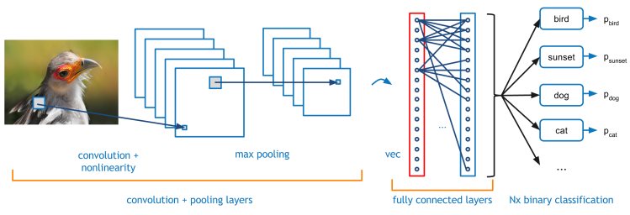
It’s a bird, it’s a … Park? Flickr solved this problem!
http://code.flickr.net/2014/10/20/introducing-flickr-park-or-bird/

Slide 11
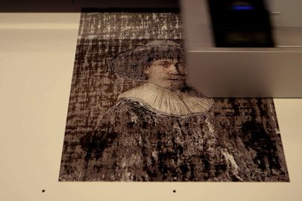
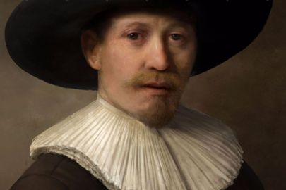
The New Frontier: PAINTING Rembrandts
http://www.wired.co.uk/gallery/new-rembrandt-painting-computer-3d-printed-gallery
Notes:
Deep learning and 3D printing used to create Rembrandts!
Examined the entire collection of Rembrandt work pixel by pixel (150 GB of data)
Anyone who’s plaid around with machine learning or modeling knows that is a crazy amount of data. Toy examples tend to come with tens of thousands of example, maybe 1MB

Slide 12
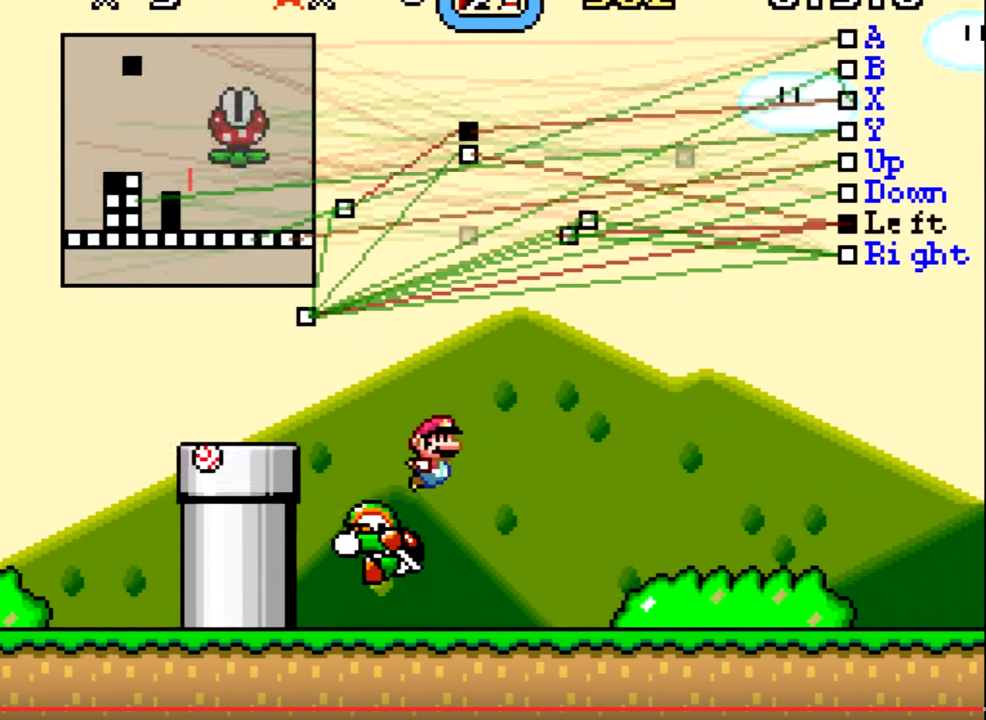
The New Frontier: Beating Mario with MarI/O
Neural Net’s that can play video games!
https://www.youtube.com/watch?v=qv6UVOQ0F44
https://pastebin.com/ZZmSNaHX
Notes:
Finally, AI doing something useful
Just that much closer to killing all goombas

Slide 13

Security
https://miovision.com/wp-content/uploads/2016/03/Security.jpg
Notes:
We all need it, but how much of it we need is a difficult question to answer. Even harder it how to get that much.
But despite being vital to all organizations, security is not straightforward to implement in practice. Many restraints exist such as time, resources, money.
The simple model of watching your traffic in real time has not been viable for years.
Snort, Suricata, Bro,

Slide 14
Security
Everyone relies on various automated tools now
Open Source (Nmap, OSSEC, Snort, Bro, OSSIM)
Black Box ( Qradar, Rapid7, Sqrrl )
Notes:
You need something to do this live.
Antiviruses are often not enough, relying purely on malicious signatures they only defend you from well known direct attacks.
At any organizational level, protecting only individual machines is not enough. You can’t just sit around and watch your own logs all the time.
But in recent times we’ve had a lot of success with a new tool for pattern matching and process analysis, and it doesn’t need any fancy static rules, or to be told much of anything. It relies on features instead of rules.

Slide 15
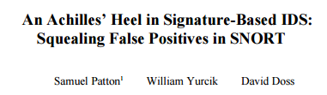
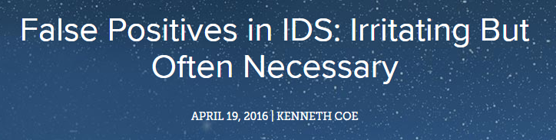
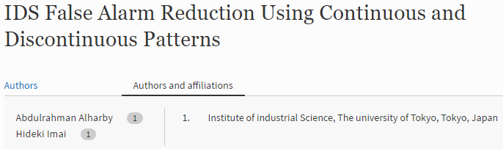
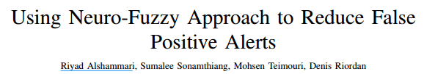
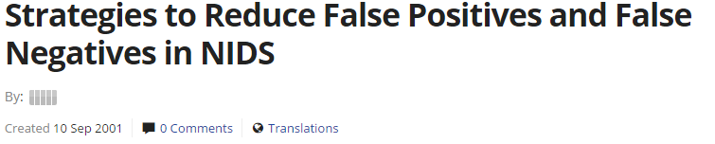
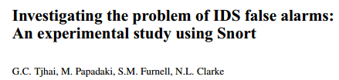
Not All information is good

Slide 16
Alert Processing

Slide 17
Alert Processing
Typical alerts look like:
#-----------------# COMMUNITY RULES#-----------------#
alert tcp $HOME_NET 2589 -> $EXTERNAL_NET any (msg:"MALWARE-BACKDOOR - Dagger_1.4.0"; flow:to_client,established; content:"2|00 00 00 06 00 00 00|Drives|24 00|"; depth:16; metadata:ruleset community; classtype:misc-activity; sid:105; rev:14;)

Slide 18
Alert Processing
alert tcp $HOME_NET 2589 -> $EXTERNAL_NET any (msg:"MALWARE-BACKDOOR - Dagger_1.4.0"; flow:to_client,established; content:"2|00 00 00 06 00 00 00|Drives|24 00|"; depth:16; metadata:ruleset community; classtype:misc-activity; sid:105; rev:14;)
Good / Bad

Slide 19
Alert Processing
Log Analysis Tools
Human Agents
Machine Learning
Statistical Models
Combination Methods

Slide 20
Applying Machine Learning
Run this “really obvious” math on your alerts and your done!
Sounds easy, only two steps, right?
Notes:
But getting things from the text book instructions to the real world rarely is as easy as we hope

Slide 21
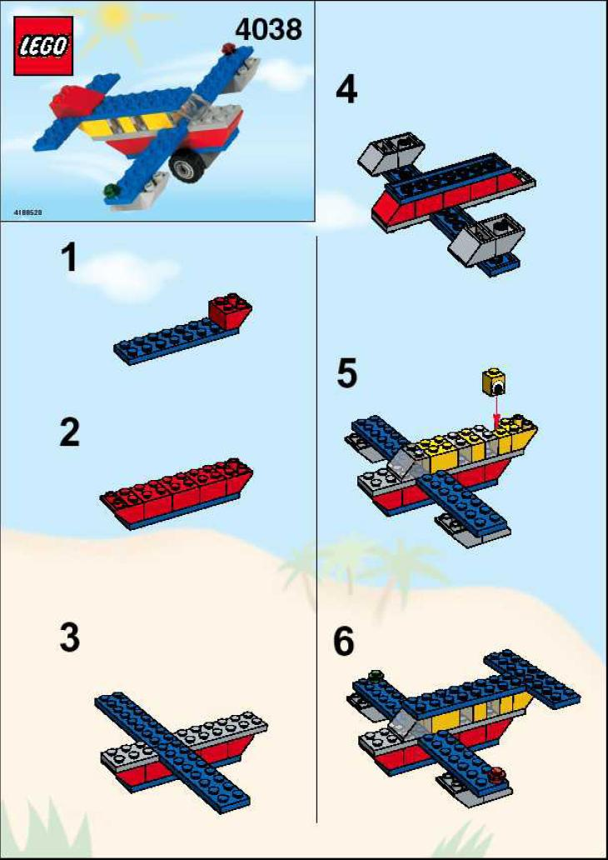

Applying Machine Learning
Expectation vs Reality
http://lego.brickinstructions.com/04000/4038/001.jpg
https://www.touchofmodern.com/sales/projector-supercenter/star-wars-death-star-blue-print?open=1
Notes:
There are a lot of little steps that go into making a successful machine learning application.
I’m not going to have the time to walk you through all of them today, but I will get you through a few basics to get you started. It is my hope today that I get at least one of you thinking about the data you see in a day to day basis, or data you’ve seen for assignments, and wonder if maybe this can be analysed in a more statistical manner.
And no, you won’t be able to play the stock market with this by the time I’m done. Because I don’t need the competition.

Slide 22
Fundamental Problems
Computers can not understand human language
They need numbers!
The choice of models/analysis is hugely important. Bad models give bad results, but complex models can make confetti out of simple data.
Notes:
So let’s go into some of the reasons these problems are hard.
Computers don’t words
Numbers have meaning in relationships. Text categories aren’t possible (See point 1). So how do we make meaningful categories?
Need to find a balance between specificity and generalization
Military story about trees maybe?
1980s pentagon wanted to learn what a tank was
made an NN, fed it soooo many pictures of tanks
it learned what trees were instead
or some people say it learned what a cloudy or sunny day was. I’ve heard both

Slide 23
Alert Processing
alert tcp $HOME_NET 2589 -> $EXTERNAL_NET any (msg:"MALWARE-BACKDOOR - Dagger_1.4.0"; flow:to_client,established; content:"2|00 00 00 06 00 00 00|Drives|24 00|"; depth:16; metadata:ruleset community; classtype:misc-activity; sid:105; rev:14;)
All these words mean nothing to a computer, they need to be told what the important parts of the sentence are.
Alerts -> Lots of words, not a lot of numbers. Your laptop can’t figure that out!
Notes:
But all these words mean nothing to a computer, they need to be told what the important parts of the sentence are.
Alerts -> Lots of words, not a lot of numbers. Your laptop can’t figure that out!
AIN’T NOBODY GOT TIME FOR THAT

Slide 24

Alert Processing
https://img.memesuper.com/8492eec6c625eac8ab07b89fe0232c11_notimejpg-aint-nobody-got-time-for-that-meme_659-372.jpeg

Slide 25
Alert Text Processing
Step One: Get rid of the garbage
There’s lots of words in sentences that provide us with context, but they don’t actually matter to a computer!
Stop Words
(as, to, of, the, this, which etc.)
The first step is to get rid of this garbage!
Notes:
Keep in mind all kinds of datasets have different versions of garbage
It is up to YOU as the scientist to figure out what the confusing/boring garbage is.
Maybe it’s a data column with no variation
Maybe some HR person decided what the features should be
Maybe it’s stop words

Slide 26
Alert Processing
“I’m here to kick ass and chew bubble-gum, and I’m all out of gum.”
“Replicants are like any other machine. They’re either a benefit or a hazard. If they're a benefit it's not my problem”
“Dammit Jim, I’m a doctor not an escalator.“
Notes:
Bonus points for anyone that can give me all 3 references
You may also not something interesting here, there’s no semblance of semantic analysis. What does that mean? After the removal of stop words we don’t know if the inflection applied is good or bad. You can immediately see that can cause problems in certain situations, beyond simply being “Doctor Escalator”.
Also notice words like “I’m” were left in. They could provide context of subjects.

Slide 27
Text Processing
Step 2:
Count word frequency for each alert. This frequency is taken over all words in alerts.
You should notice here that this will be the a very sparse matrix as each alert will contain only a small subset of all possible words.

Slide 28
Alert Processing
If you’re quick, you may notice an immediate problem with this:
More descriptive and/or longer alerts will have more words in them!
To overcome this normalize the frequency of each word by the length of the document!

Slide 29
Term Frequency
“Replicants are like any other machine. They’re either a benefit or a hazard. If they're a benefit it's not my problem”
Word | Frequency
They’re | 2
Benefit | 2
Replicants | 1
Like | 1
Machine | 1
Etc.
Notes:
What can we deduce about word frequency and importance?
We can also see that longer boddies of text will repeat some words more often, driving up their weights.

Slide 30
Alert Processing
This measure is known as TF-IDF and is commonly deployed in Information Retrieval and Data Mining
Word | Ex 1 | Ex 2 | Ex 3
I’m | 2/15 | 0/21 | 1/8
Chew | 2/15 | 0/21 | 0/8
Replicant | 0/15 | 1/21 | 0/8
Doctor | 0/15 | 0/21 | 1/8

Slide 31
OSSEC Data
Manually took an assortment of 100 rules
Brute Force
Blacklisted User Agent
Viruses/Adware/Spyware Detected
Authentication Failed
Using Machine Learning for IDS Detection

Slide 32
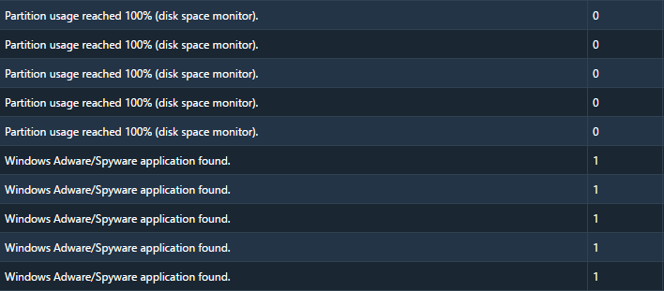
OSSEC Data

Slide 33
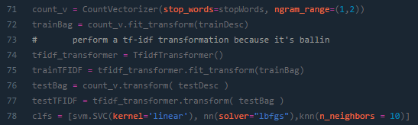
OSSEC Data

Slide 34
OSSEC Data
Index TF-IDF
(0, 39) 0.382644667163
(0, 90) 0.382644667163
(0, 13) 0.348566137414
(0, 80) 0.382644667163
(0, 40) 0.382644667163
(0, 91) 0.382644667163
(0, 14) 0.382644667163
(1, 20) 0.279747417715
Index TF-IDF
(1, 8) 0.35712372899
(1, 78) 0.35712372899
(1, 89) 0.35712372899
(1, 21) 0.279747417715
(1, 69) 0.35712372899
(1, 9) 0.35712372899
(1, 79) 0.35712372899
(1, 89) 0.35712372899

Slide 35
Results
Garbage in, garbage out
Perfect | Noisy | Random
Naive Bayes w/ Only Descriptions Balanced Accuracy: 1.0000 AUC of ROC: 1.0000 | Naive Bayes w/ Only Descriptions Balanced Accuracy: 0.5972 AUC of ROC: 0.5449 | Naive Bayes w/ Only Descriptions Balanced Accuracy: 0.6533 AUC of ROC: 0.5983

Slide 36
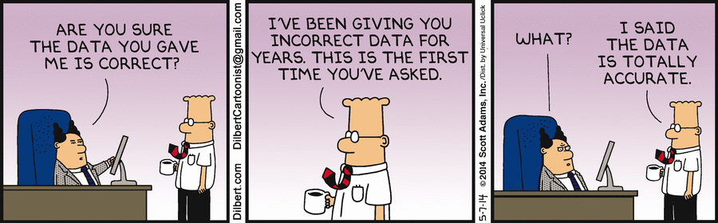
But Watch Out
Garbage In, Garbage Out
http://alison.dbsdataprojects.com/wp-content/uploads/sites/82/2016/04/cartoon-metadata.png
Notes:
Now we’ve got some data, and that’s a big step, but now we need to consider the limitations of your data.
A lot of people have the idea that you can just toss everything at a model, or AI, and it will magically find the answer. Remember, you’re training an expert here, but it is going to start out as a novice. If you don’t understand some of the variations in your data your expert may look more like Homer Simpson than Scotty.

Slide 37
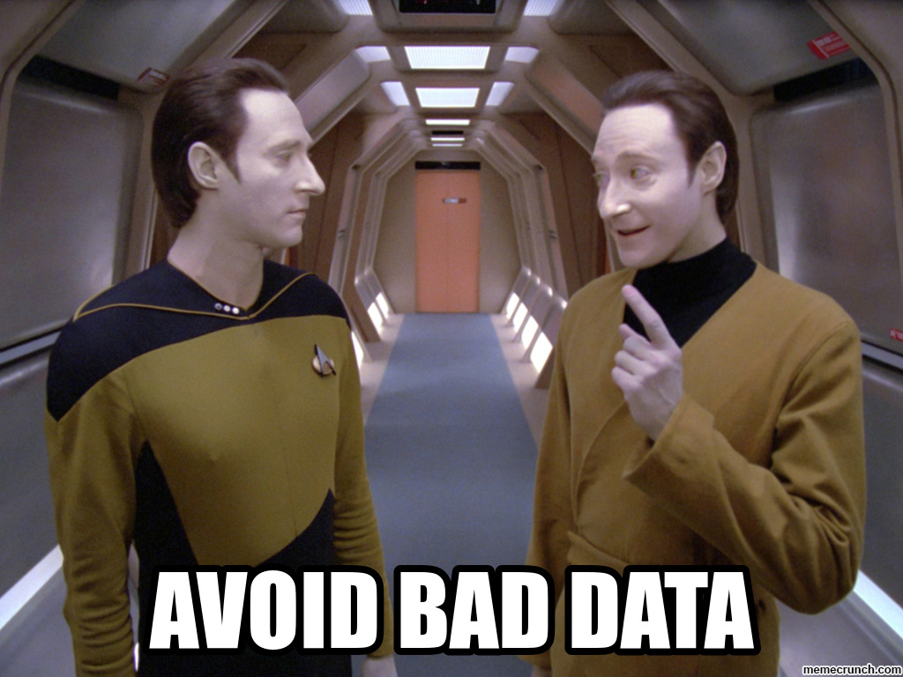
Alert Processing
http://memecrunch.com/meme/1UJJT/avoid-bad-data/image.jpg

Slide 38
Things to consider
How well does your data represent certain behavior?
How balanced are the different classes of your data?
Are there inherent patterns to your data?
Do all of your features have variance?

Slide 39
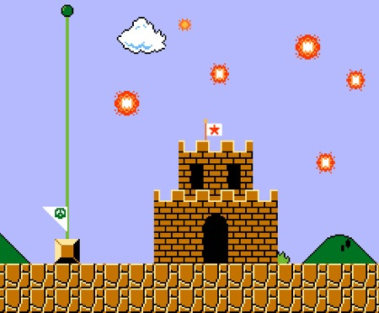
Congratulations
You just did Data Science!
http://www.themoderndaypirates.com/pirates/wp-content/uploads/2010/10/fireworks.jpg

Slide 40
Advanced Measures for the real keeners
Hash Vectorizer
Tokenization (nothing to do with rings or Hobbits)
One Hot Encoding
Binary Encoding

Slide 41
Model Selection

Slide 42
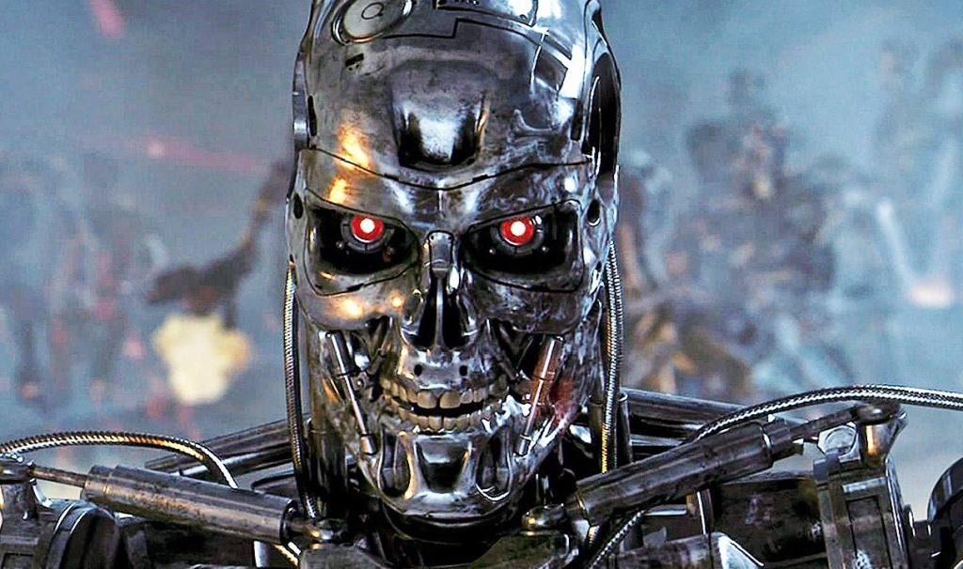
Model Selection
IPs
Meta Features
Time Stamps
Phonetic Descriptions
http://urblife.com/wp-content/uploads/2014/12/TerminatorGenisys1.jpg
Notes:
Now that you’ve got something tasty for your robots, it’s time to feed this data into your analytical engine!
Some of your features (timestamps, IPs) are great for clustering to see activity windows, targets or destinations.
Others, such as alert descriptions, are perfect to feed to statistical models to try and narrow down malicious events.

Slide 43
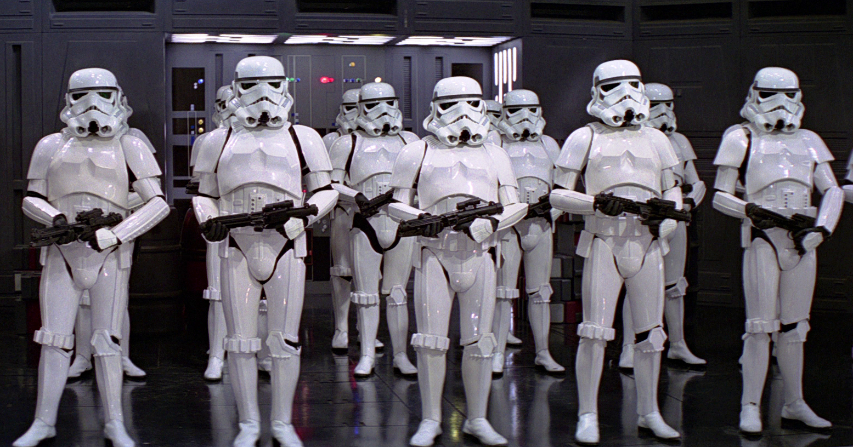
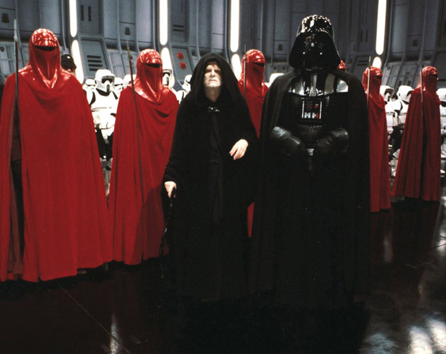
Model Selection
http://static.comicvine.com/uploads/original/11116/111167334/4917403-3067156411-Storm.png
http://sneakernews.com/wp-content/uploads/2011/02/star-wars-imperial-guard.jpg
Notes:
Lets take our alerts from a gaggle of bland henchmen to a few elite warnings!
So lets go from a bunch of stupid alerts to Fewer high quality alerts

Slide 44
Model Selection
What kind of things do you want to do with your data?
Classification: is this a bad thing or not?
Clustering: is this thing like the other things?
Modeling: is this kind of thing happening?

Slide 45

http://mocklogic.com/wp-content/uploads/2016/05/don__t_panic_by_vigilantmeadow.jpg
Notes:
Don’t panic
I’m not going to do math
But I’ll give you some overviews

Slide 46
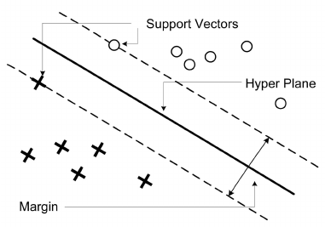
Support vector machines
Uses vector of features
Each vector has a weight (support)
Try to maximize the hyperplane space between these vectors
Notes:
Let’s start out first with a few basic models
Hyperplanes and coolness
Pros: Traditionally very strong classifiers
Many years of success, research and implementation
Cons: Do not handle large training sets very well
Do not handle large feature spaces very well
Need a few tricks to handle multi classes
Parameter selection can be tricky

Slide 47
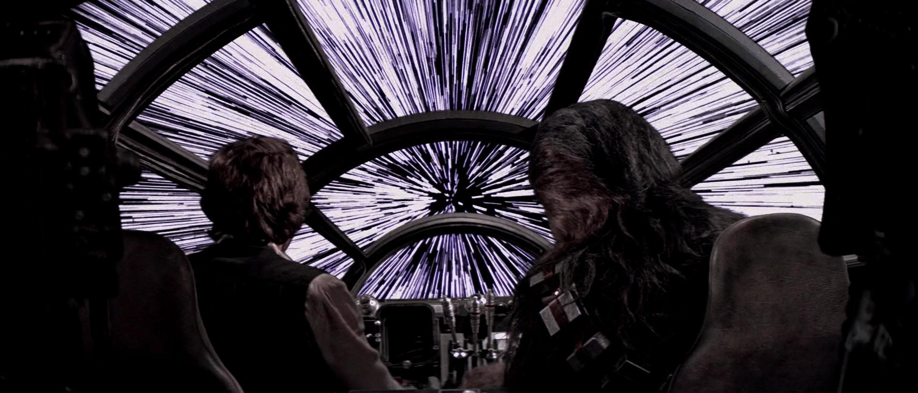
Punch it Chewie!
http://i.imgur.com/FEdl3xQ.jpg

Slide 48
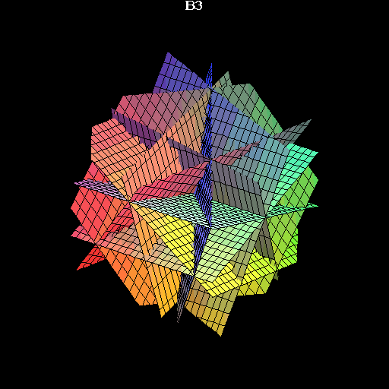
Classification: Support Vector Machines
Relies on hyperplanes
Re. The distance between two objects where every feature is a dimension.

Slide 49
Support vector machines
Uses vector of features
Each vector has a weight (support)
Try to maximize the hyperplane space between these vectors
Notes:
Let’s start out first with a few basic models
Hyperplanes and coolness
Pros: Traditionally very strong classifiers
Many years of success, research and implementation
Cons: Do not handle large training sets very well
Do not handle large feature spaces very well
Need a few tricks to handle multi classes
Parameter selection can be tricky

Slide 50
Classification: Support Vector Machines
Packages:
Libsvm (C)
e1071 (R)
scikit-learn (Python)
Shogun(Python, C++)
Hector(Go)

Slide 51

Classification: Neural Networks
Made to emulate how the brain works
Each neuron is a small decision function
Been around since the 60’s but only recently become powerful
http://cs231n.github.io/assets/nn1/neural_net.jpeg
Notes:
This is an architecture made to emulate the brain. Basically you take a neuron and it is given some input ( a letter or shape) and from that it applies a function and produces output.
These little guys have been around since the 60s, and was theorized that they could be made to solve literally ANY problem.
Sadly for a lot of reasons it didn’t work out like that, and for about the next 30-40 years not much was done with them.
Recently through a lot of advances in computation power, techniques and design we have made some tricks that make these things amazingly powerful.
They are what power the concept of Deep Learning, which uses many many layers of these little guys talking back and forth to learn various features of a problem and make decisions that we previously thought next to impossible.
Deep learning is what has driven recent advances in computer vision!
Pros: Successful in fields previously deemed impossible for computer understanding
Lots of current research and top notch implementations by large organizations
Cons: Difficult math to understand
Many different flavors
Black box decision making processes ( we don’t know what they’re thinking )

Slide 52
Neural networks
Packages:
PyTorche (Facebook)
TensorFlow (Google)
OpenNN( C++ )

Slide 53
Let’s Compare Some Results
Models
Support Vector Machines
Neural Networks
Data
1999 KDD Cup Events
(ACM Special Interest Group on Knowledge Discover and Data Mining)
http://kdd.ics.uci.edu/databases/kddcup99/kddcup99.html

Slide 54
KDD Profile
Types of traffic:
Normal 10000 cases
500 Labeled as “noise”
Buffer Overflow 30
Rootkit 10
Satan 1589
TearDrop 979
Notes:
Normal Traffic
Buffer overflow attacks
Smurf ddos
Satan ransomware
Teardrop dos attack

Slide 55
KDD Features
Duration
Protocol Type
Service
Flag
Source Bytes
Dest Bytes
Land
Wrong Fragment
Urgent
Hot
Number Failed
Logged In
Root Shell
Etc.
Source: http://kdd.ics.uci.edu/databases/kddcup99/kddcup.names
Notes:
Normal Traffic
Buffer overflow attacks
Smurf ddos
Satan ransomware
Teardrop dos attack

Slide 56
That’s All!
Let’s Compare Some Results
 | SVM | Neural Network
Benign Predictions | 6405 / 6407 | 5986 / 6407
Malicious Predictions | 755 / 1271 | 908 / 1271
Balanced Accuracy | 96.14 | 81.18
Area Under the Curve | 79.69 | 82.58

Slide 57
That’s All!
Let’s Compare Some Results
Descriptions
 | SVM | Neural Network
Benign Predictions | 17 / 20 | 17 / 20
Malicious Predictions | 11 / 11 | 11 / 11
Balanced Accuracy | 89.29 | 89.29
Area Under the Curve | 92.50 | 92.50

Slide 58
Take away
Machine learning is not a silver bullet
Machine learning is NOT guaranteed to kill all humans
That giant drive of logging and data is not useless
Machines need numbers, not human readable data
Text can be transformed into this format
Not all models and data are made the same
Be the most careful when modeling, filtering and selecting your data

Slide 59
Further Resources
http://distill.pub/
http://www.kdnuggets.com/
https://blog.google/topics/machine-learning/
https://www.reddit.com/r/MachineLearning/

Slide 60

Take away
https://i.ytimg.com/vi/P4LhWSN3YSw/maxresdefault.jpg

Slide 61
One Last Thing
All materials available at:
github.com/akeddy/AtlSecCon2017
Special Thanks To:
GoSecure
AtlSecCon
NRC

Slide 62
Additional Content

Slide 63
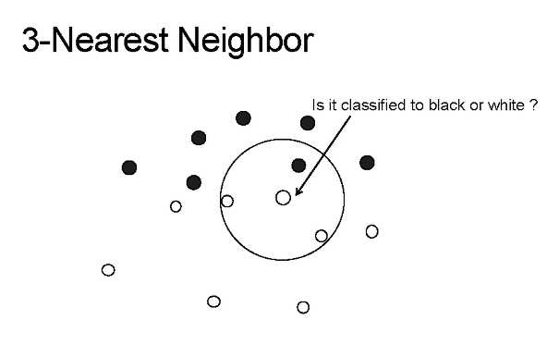
Classification: K Nearest neighbors
Clustering ln a per point basis
Each data point is placed in a feature space (often visualized as 2D)
The K nearest points are then taken, and their labels averaged to apply a label to the new point
http://sens.tistory.com/277
Notes:
Simple feature space distance
Pros: We know why every decision is made
Easy to make and implement from scratch
Have to define the number of neighbors
good for when you have little knowledge of the data
good for searching!
Cons: Overly simplistic for many problems

Slide 64
Packages:
Scikit-Learn (Python)
Class Library (R)
Node-Nearest-Neighbor (Javascript)

Slide 65
That’s All!
Let’s Compare Some Results
 | SVM | Neural Network | KNN
Benign Predictions | 6405 / 6407 | 5986 / 6407 | 6375 / 6407
Malicious Predictions | 755 / 1271 | 908 / 1271 | 892 / 1271
Balanced Accuracy | 96.14 | 81.18 | 95.15
Area Under the Curve | 79.69 | 82.58 | 84.98

Slide 66
That’s All!
Let’s Compare Some Results
Descriptions
 | SVM | Neural Network | KNN
Benign Predictions | 17 / 20 | 17 / 20 | 11 / 20
Malicious Predictions | 11 / 11 | 11 / 11 | 8 / 11
Balanced Accuracy | 89.29 | 89.29 | 62.82
Area Under the Curve | 92.50 | 92.50 | 63.86

Slide 67
String Lamda-ization
This is all about stem words!
Run -> Running -> Ran -> Runny

